Slide 1

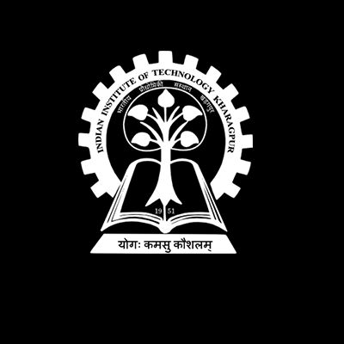

Kharagpur RoboSoccer Students’ Group
Abhinav Agarwal
(Under constrcution)
Notes:
Introduction : Kumar Abhinav

Slide 2
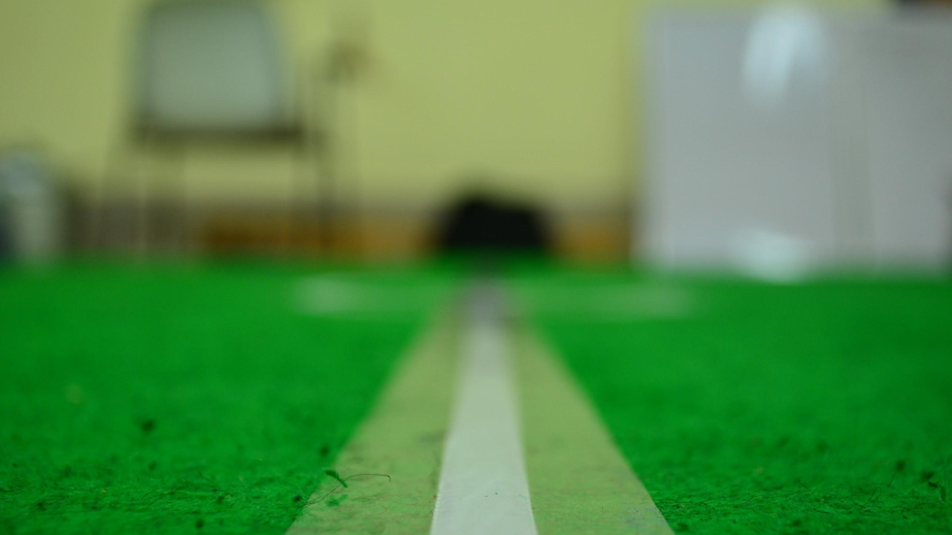
What we do ?
Build autonomous soccer playing robots
Participate in International competitions

Slide 3
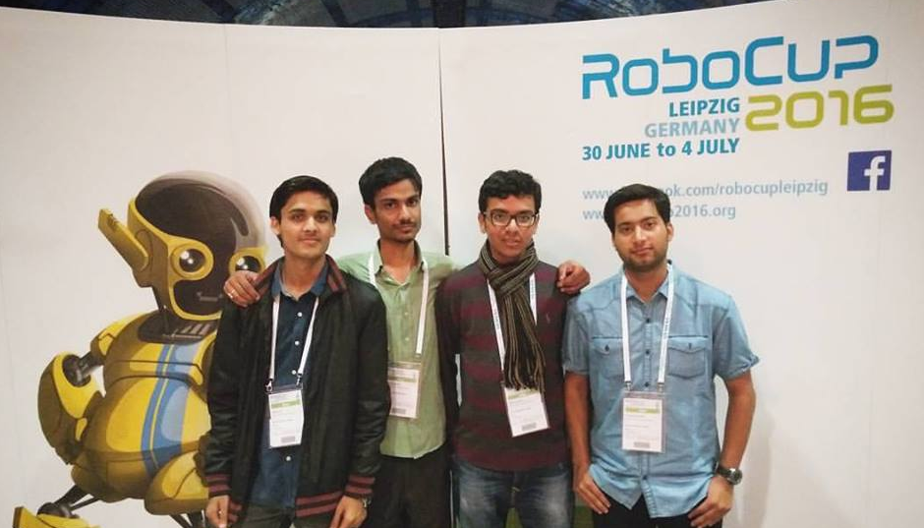
Defeated HfutEngine3D (Hefei University of Technology, China) in Robocup3d.

Slide 4
Results*
(scores with other 4 teams not shown)
Robocup
3D simulation
Leipzig Germany
2016
(KgpKubs vs) | ITAndroids | HfutEngine | Miracle3D | magmaOffenburg
Seeding Round | 1-1 | - | - | 0-1
Round 1 | - | 2-0 | - | 0-5
Elimination | - | 2-1 | 1-1 | -
Round 2 (1) | 0-0 | - | - | -
Round 2 (2) | 1-0 | - | - | -
KgpKubs | India | Playing since 2016
ITAndroids | Brazil | Playing since 2011 ^{[source]}
HfutEngine | China | Playing since 2005 (in China) and since 2008 (globally) ^{[source]}
Miracle3D | China | Playing since 2012 (state level) and since 2013 (globally) ^{[source]}

Slide 5

Qualified for Robocup 3D Simulation League Japan, 2017

Slide 6
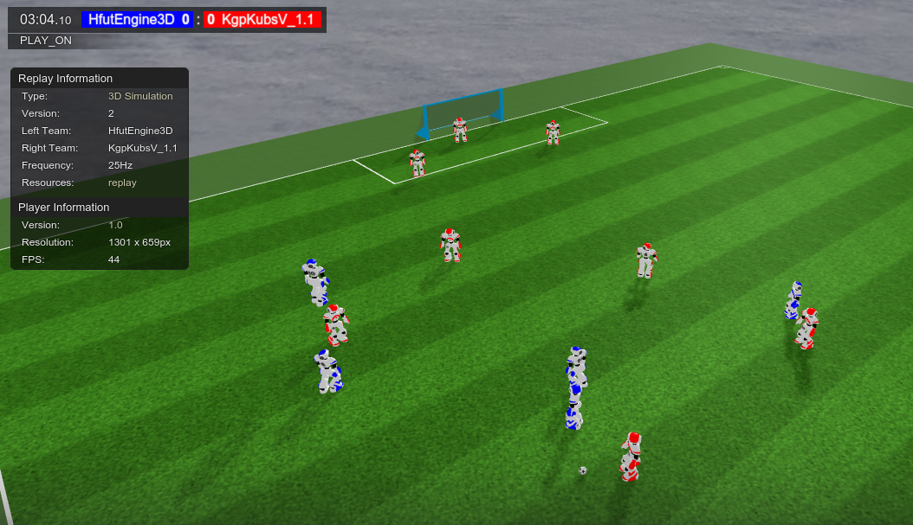

Slide 7
Robocup 3DSimulation
11 simulated humanoids play in a simulation environment with realistic physics, state-noise.
Introduction

Slide 8
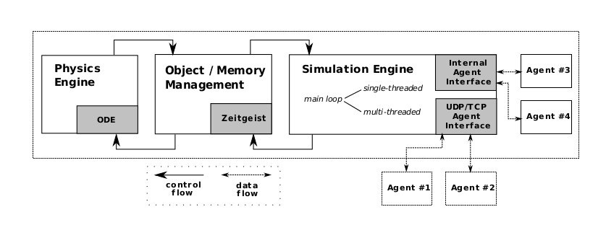
Robocup 3DSimulation
The RoboCup 3D simulation environment is based on SimSpark (based on Open Dynamics Engine)
Communication to server is done via TCP.
Each bot is run on a separate process
Simulator

Slide 9
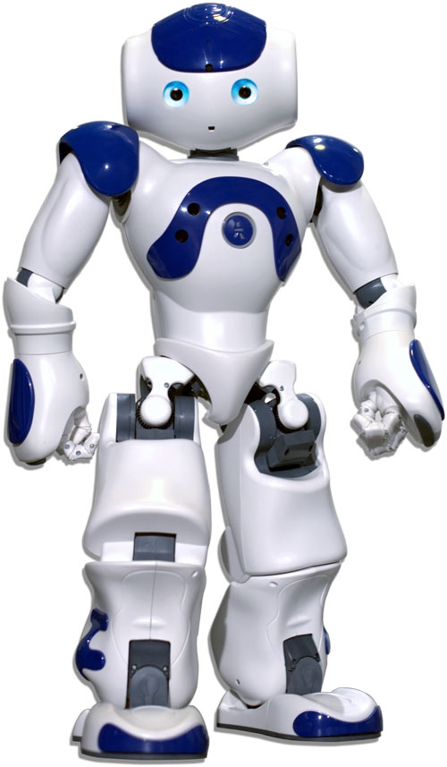
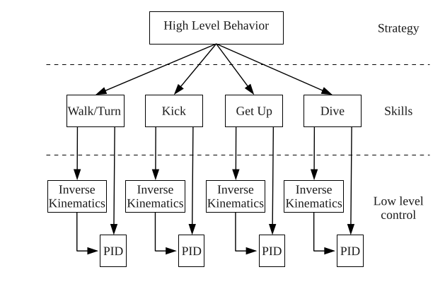
Robocup 3DSimulation
22 hinges to control motion
The camera has a field of view 120 degrees wide.
Agents can talk and hear to communicate.
Agent
Notes:
In robotics, inverse kinematics makes use of the kinematics equations to determine the joint parameters that provide a desired position for each of the robot's end-effectors. Specification of the movement of a robot so that its end-effectors achieve the desired tasks is known as motion planning.

Slide 10
Robocup 3DSimulation
11 Players
Architecture
Goalkeeper
On Ball
Remaining 9 players
Drive Ball to goal or take ball in possession
Team formation - delaunay triangulation
Goalkeeper
Heuristics
Role Assignment - Hungarian Algorithm
Notes:
In robotics, inverse kinematics makes use of the kinematics equations to determine the joint parameters that provide a desired position for each of the robot's end-effectors. Specification of the movement of a robot so that its end-effectors achieve the desired tasks is known as motion planning.

Slide 11
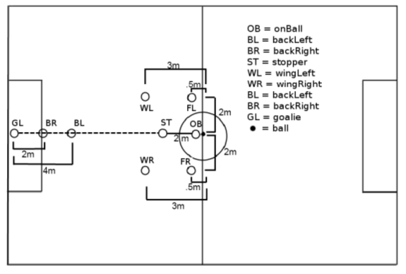
Robocup 3DSimulation
Team formation is determined by the ball position.
We use Delaunay Triangulation method to generate and coordinate player positions.
Team Formation

Slide 12
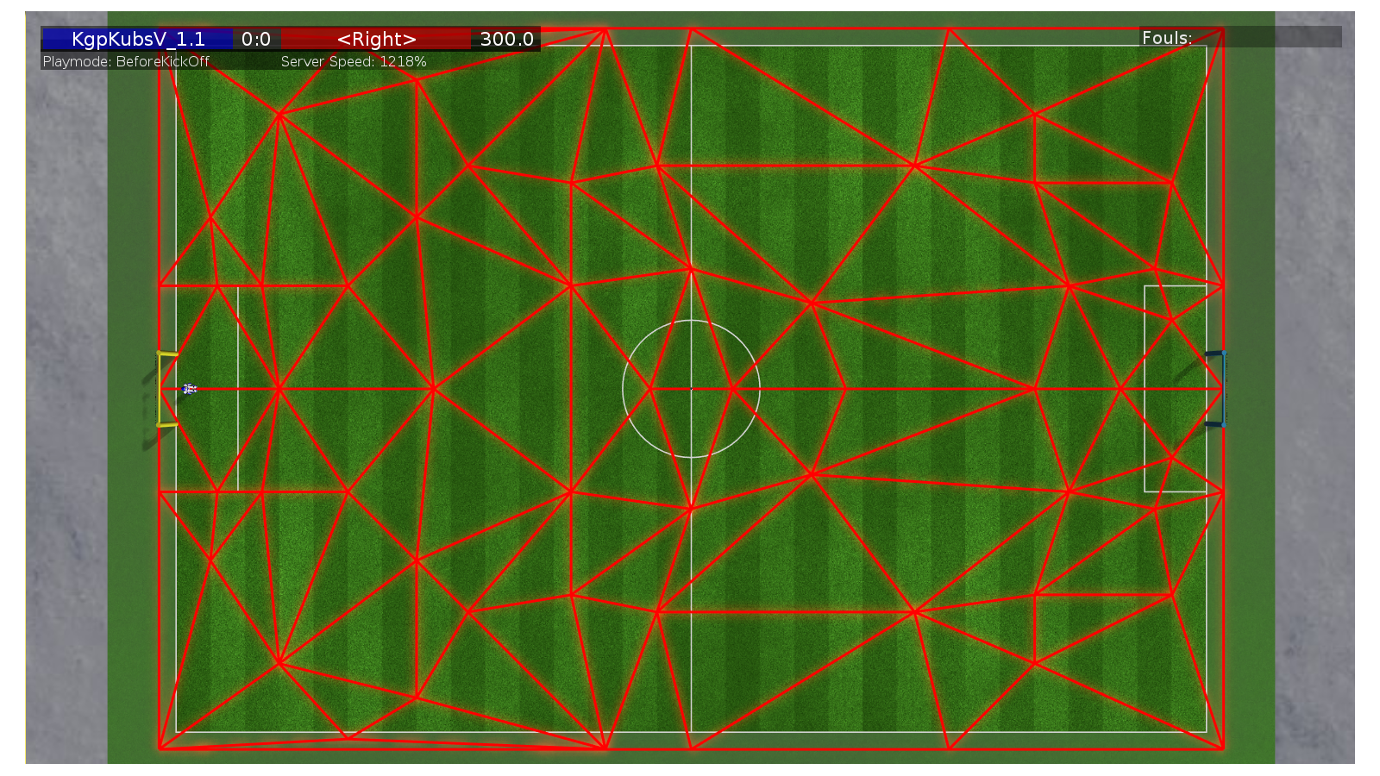
Robocup - 3D Simulation League
Diagram 1
The Delaunay Triangles Created

Slide 13
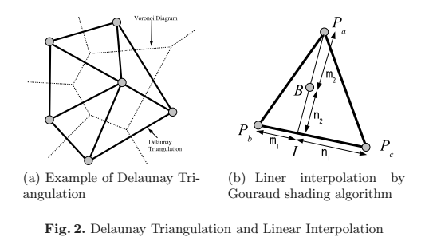
Robocup - 3D Simulation League
Diagram 2
The Algorithm Description

Slide 14
Robocup - 3D Simulation League
Role assignment should
Minimize longest distance
Avoiding collisions
Dynamically consistent
Minimum Maximal Distance Recursive (MMDR) function is chosen.
Role Assignment
Show it satisfy above props
Notes:
a role assignment function, which takes as input the
state of the world, and outputs a one-to-one mapping of players to roles.
MMDR minimizes the longest distance (Property 1) as
the lexicographical ordering of distance tuples sorted in de-
scending order ensures this. If two agents in a mapping are
to collide (Property 2) it can be shown, through the trian-
gle inequality, that MMDR will find a lower cost mapping
as switching the two agents’ targets reduces the maximum
distance either must travel. Finally, as we assume all agents
move toward their targets at the same constant rate, the dis-
tance between an agent and any target will not decrease any
faster than the distance between any agent and the target that
agent is assigned to. This observation provides dynamic con-
sistency (Property 3) by preserving the lowest lexicographi-
cal cost ordering of a MMDR mapping across all timesteps.

Slide 15
Robocup - 3D Simulation League
Role Assignment

Slide 16
Robocup - 3D Simulation League
Stable and fast walking is biggest bottleneck.
State space is very large with 22 joints each having multiple degrees of freedom.
Parameter Optimization
Notes:
a role assignment function, which takes as input the
state of the world, and outputs a one-to-one mapping of players to roles.
MMDR minimizes the longest distance (Property 1) as
the lexicographical ordering of distance tuples sorted in de-
scending order ensures this. If two agents in a mapping are
to collide (Property 2) it can be shown, through the trian-
gle inequality, that MMDR will find a lower cost mapping
as switching the two agents’ targets reduces the maximum
distance either must travel. Finally, as we assume all agents
move toward their targets at the same constant rate, the dis-
tance between an agent and any target will not decrease any
faster than the distance between any agent and the target that
agent is assigned to. This observation provides dynamic con-
sistency (Property 3) by preserving the lowest lexicographi-
cal cost ordering of a MMDR mapping across all timesteps.

Slide 17
Robocup - 3D Simulation League
The walk engine uses sinusoidal functions to create the motions of the limbs.
Walk engine processes desired walk velocities and positions and uses inverse kinematics to determine the joint positions
Using PID controller, torque commands are sent to joints.
This walk engine is parameterized by set of 40 parameters
Walk engine
Notes:
a role assignment function, which takes as input the
state of the world, and outputs a one-to-one mapping of players to roles.
MMDR minimizes the longest distance (Property 1) as
the lexicographical ordering of distance tuples sorted in de-
scending order ensures this. If two agents in a mapping are
to collide (Property 2) it can be shown, through the trian-
gle inequality, that MMDR will find a lower cost mapping
as switching the two agents’ targets reduces the maximum
distance either must travel. Finally, as we assume all agents
move toward their targets at the same constant rate, the dis-
tance between an agent and any target will not decrease any
faster than the distance between any agent and the target that
agent is assigned to. This observation provides dynamic con-
sistency (Property 3) by preserving the lowest lexicographi-
cal cost ordering of a MMDR mapping across all timesteps.

Slide 18
Robocup - 3D Simulation League
CMA-ES is parallel search, evolutionary algorithm
To get fitness value for a candidate, it must connect to server in usual way and simulate walk.
Running optimisation on 8 core cpu for 2 days we were able to increase walk speed by 15%
Optimizing walk engine
CMA-ES

